Slide 1
pow(10,x) vs powf(10,x)
sqrt(x) vs sqrtf(x)
exp(10,x) vs expf(10,x)
Log(x) vs logf(x)
log10(x) vs log10f(x)

Slide 2
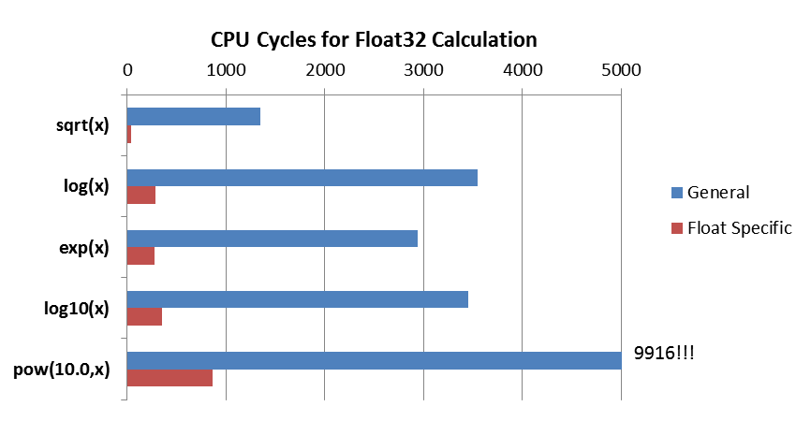
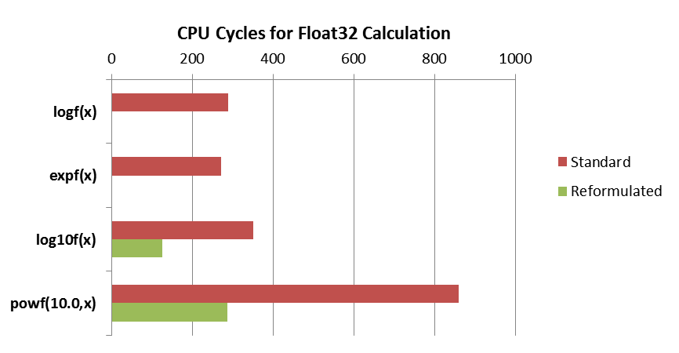
Smaller is Better
Smaller is Better

Slide 3
sqrt(x)
Teensy 3.6
ARM Cortex M4F
NXP K66
180 MHz
sqrtf(x)
log(x)
logf(x)
exp(x)
expf(x)
log10(x)
log10f(x)
pow(10,x)
9916!!
powf(10,x)
Smaller is Better
Function | Cycles |  | Function | Cycles |  | Speed Up
sqrt(x) | 1349 |  | sqrtf(x) | 43 |  | 31.2x
log(x) | 3553 |  | logf(x) | 289 |  | 12.3x
exp(x) | 2943 |  | expf(x) | 271 |  | 10.9x
log10(x) | 3452 |  | log10f(x) | 350 |  | 9.9x
pow(10.0,x) | 9916 |  | powf(10.0,x) | 860 |  | 11.5x

Slide 4
